Slide 1
Pitchbook
The current Manitoba ELA K-12 Curriculum is a series of activities focused on isolated skills and strategies.
Gr. 12
Gr. 12
KG
Does the Current Manitoba ELA K-8 Curriculum Meet the Needs of all Students?
Revising the Manitoba ELA K-8 Curriculum
A phased-in implementation

Slide 2
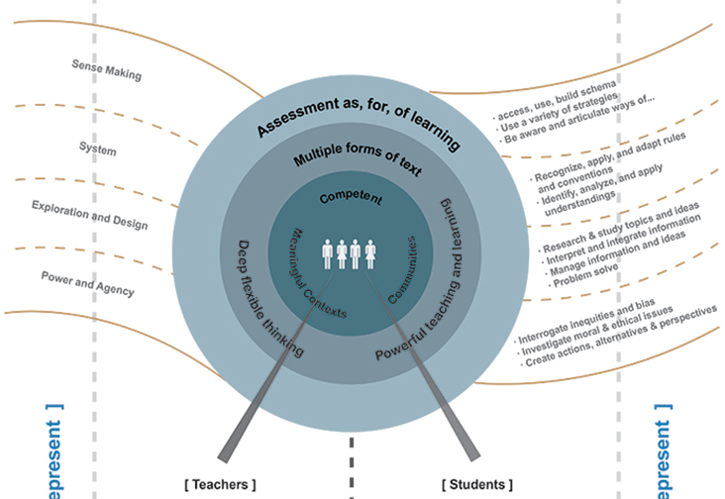
Why revise the ela curriculum?
Rationale for ELA Changes
.
Our current ELA curriculum focuses on a series of activities, isolated skills and strategies.
Moving forward, Manitoba’s ELA curriculum must:
Be evidence and research-based
Focus on students as competent literacy learners who build upon their competencies
Support learning in complex, authentic, rich, meaningful contexts
We Want Students to Be
Active learners who co-construct their learning and develop awareness of identities in school, home, the community and the world as well as understand the many purposes, uses and power of language
Flexible, reflective, critical thinkers who participate in complex and meaningful contexts for personal, social and academic purposes
Guiding Principles: Language is . . .
Four ELA Practices
Central to all learning and understanding ourselves, communities and world
Contextual, multi purposed and socially constructed
Complex, continuous, evolving and individual to wide-ranging language demands
Sense Making
Exploration & Design
System
Power and Agency

Slide 3
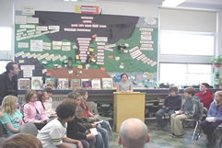
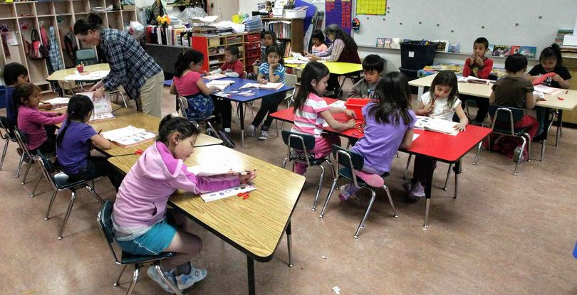
What should ela classrooms look like?
What Should ELA Practices Look Like?
Support Language Choices: Use language as Sense Making to assess and build prior knowledge by using generative content. The curriculum is co-constructed to address issues students and teachers consider important. Students understand information by using strategies and communicate in effective ways for purpose and audience.
Create New Knowledge: Use language as Exploration and Design to deepen students’ knowledge for themselves and others for personal, social and academic needs. Create new ideas and solve problems through research, inquiry, interpreting and communicating.
Take Transformative Action: Use language as Power and Agency to foster critical thinking, explore and analyze inequalities, viewpoints, biases and investigate issues and conflicts for greater equity at school, home, community and the world.
Build Competencies & Self Actualize: Use language as a System to metacognitively investigate, understand and apply how language works as patterns, relationships and conventions for communication and making meaning: decoding, coding, grammar, spelling, vocabulary.
Which classroom uses guiding principles of language and ELA practices to support students’ personal,
social, academic and global competencies?
Rockwood School, Multiage Class Gr. 4, 5, 6
Waywayseecappo First Nation, KG class

Slide 4
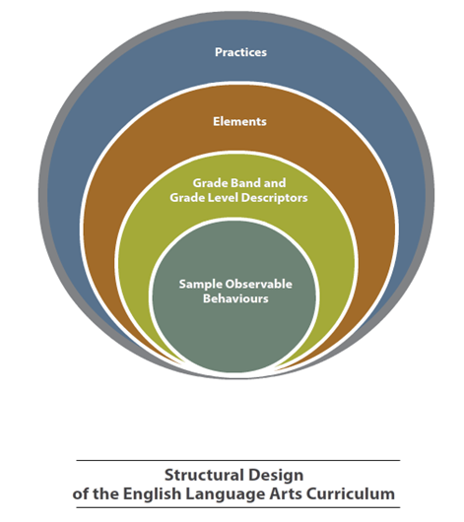
How is the revised ELA curriculum structured?
Structure of ELA Curriculum
Elements describe the four language practices, grounding teaching and learning, enacted in all K-12 grade levels
Practices and elements are grouped into three bands (K-2, 3-5, 6-8) with descriptors. These support teachers in long-term reflection on student learning and progress and help build student portfolios over time (grade/band)
Sample of Observable Behaviors provide what students might say or do
Nested System- Interrelated ways teachers and students learn in context
Time Frames for ELA 35% of flexible instructional time; No more than half of that time consists of non-contextualized Programmatic Structures. Daily Read alouds and independent textual interactions for 30 minutes not including instructional time.
Purposeful Assessment
Assessment for Learning (AFL): Teachers observe what students know and do to give constructive feedback and guide instruction
Assessment as Learning (AAL): Students take responsibility for what they know and do and develop awareness to make informed decisions about their learning
Assessment of Learning (AOL): All stakeholders, including the broader education community, are informed to celebrates successes and plan next steps for continuous progress.

Slide 5
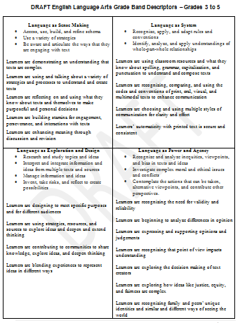
How do we Plan for teaching and learning?
Planning for Meaningful Learning
Meaningful topics based on student interests, other disciplines and literature themes. Ensure topics are rich enough to engage students in all four ELA practices. (The study of extinction not dinosaurs).
Different lenses (personal, philosophical, social, cultural, historical, imaginative and literary, environmental and technological) used to enrich questioning and learning framework.
Flexible approaches used to design instruction (multi-genre thematic design, genre inquiry, interdisciplinary, author study, etc.)
Practice
Elements
Grade Level/ Grade Band Descriptors
Where Are We Going?
Get everyone involved in
Dialoguing (strengths/ weaknesses/ problems/solutions)
Share and develop resources and support systems
Create models and templates for flexible planning
Gather and reflect on teaching and learning evidence for continuous progress

